Slide 1

Crowdfunding in Blockchain
SRM INSTITUTE OF SCIENCE AND TECHNOLOGY
FACULTY OF ENGINEERING AND TECHNOLOGY
DEPARTMENT OF DATA SCIENCE AND BUSINESS SYSTEMS
18CSE344T – Final Project Review
Praveen Prakash Tiwari / RA2011050010003
Md Anas Hasan / RA2011050010011
Guide name: Dr. SV. SHRI BHARATHI
Designation: Assistant Professor /DSBS

Slide 2
Table of contents
Introduction
Abstract
Objective
Tool Used
Explanation about the tool
Algorithm
Description of Algorithm
Architecture diagram
Modules
Experimental Results
Output Screenshots
Coding
Reference Papers

Slide 3
BetterFund
Presented by :
Crowdfunding Platform powered by Blockchain
Praveen Prakash Tiwari (RA2011050010003)
Md Anas Hasan (RA2011050010011)

Slide 4
01.
Introduction
Problem Statement
Abstract

Slide 5
Introduction
Crowdfunding is one of the most popular ways to raise funds for any project, cause or for helping any individual in need. With the onset of Covid we have seen a rise in Crowdfunding activities across the globe which includes small campaigns to help people get oxygen and medical help to large funds such as PM Cares.

Slide 6
Major Problems
Security
Transparency &
Anti-Fraud
Global Contribution

Slide 7
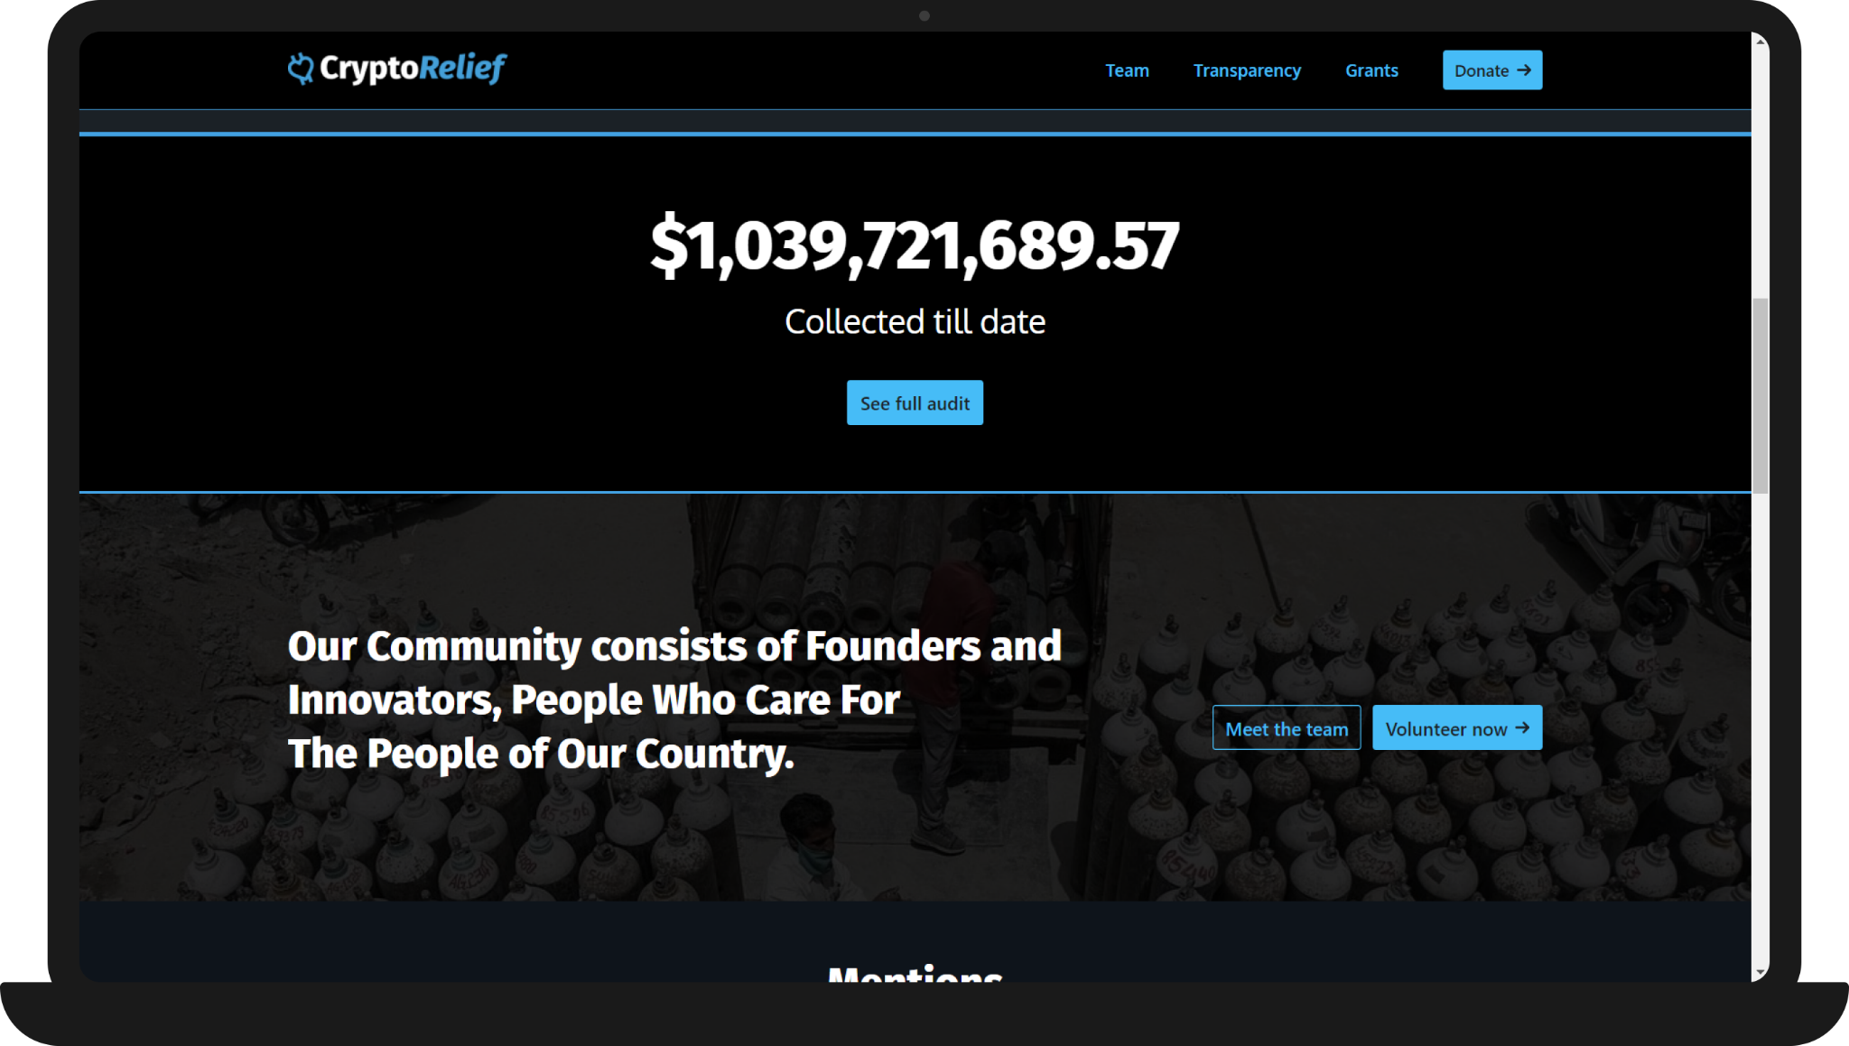
We were highly inspired by the Indian Crypto Community ( www.cryptorelief.in ) which raised
~1 billion dollars for Covid Relief in India and how transparent they were during the entire process.

Slide 8
Abstract : Technical & Non-Technical
Technical
It is to be a ReactJS based application, which will be supported by any web browser.
Internet connectivity will be required.
Users will require ‘Metamask’ browser extension to sign transactions.
Social
Crowdfunding over the years has helped people but has also seen heavy frauds in the name of Crowdfunding. With Betterfund we want to bring transparency to the process of crowdfunding and build trust among people to contribute to all the causes.

Slide 9
Abstract : Technical & Non-Technical
Economic
Given the Ethereum Blockchain provides us with most of the security features, the development does not require much cost.
The only cost would be the server cost of the deployed application.
Scope
With Betterfund we aim to make the crowdfunding process transparent, anti-fraudulent and secure.

Slide 10
02.
Proposed
Solution
Detailed Solution (Objective)

Slide 11
Detailed Solution (Objective)
Any web based application is a centralized application which means that anything we do on the platform is managed by a server which is owned by a single company.
We propose a Decentralized Application powered by Ethereum Blockchain, where all the information about campaigns, contributions, withdrawal requests and funds are kept on a Blockchain Network, visible to all and decentralized. This means the funds and transactions are visible to and stored at every node on the blockchain, and prevents the data from being stored in a centralized server, single location.
Hence not letting the money get into the hands of anyone and eliminating every possibility of it getting misused — an elegant and logical solution to the problem in hand.

Slide 12
03.
Technical Analysis
Tech Stack

Slide 13
Tech Stack Analysis
Optimized
For
speed
Efficient
Secure
In order to achieve the solution we have chosen a tech stack that is

Slide 14

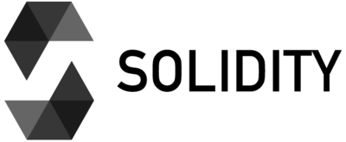

Tech Stack Analysis
The Technologies that have been used are :
NextJS
Next.js is an open-source React front-end development web framework that enables functionality such as server-side rendering and generating static websites for React based web applications.
Chakra UI
Chakra UI is a simple, modular and accessible component library that gives the building blocks one needs to build React applications.
Solidity
It is the programming language for implementing Ethereum based Smart Contracts.

Slide 15
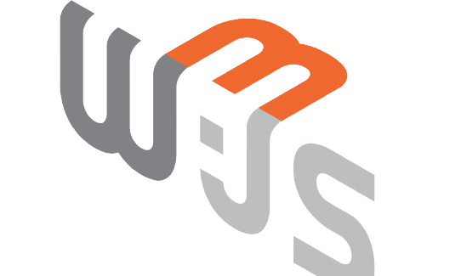
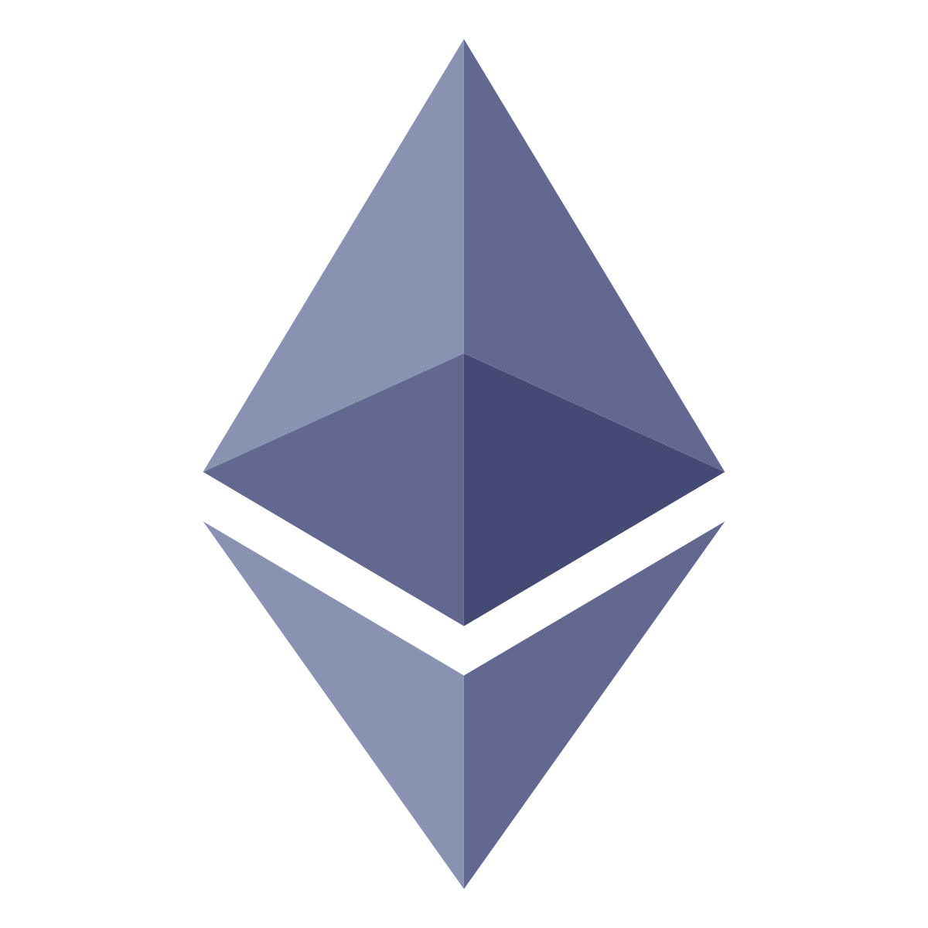
Tech Stack Analysis
The Technologies that have been used are :
Web3
web3.js is a collection of libraries that allow you to interact with a local or remote ethereum node.
Ethereum Smart Contract
It is the collection of functions and data that reside at a specific address on the Ethereum Blockchain.

Slide 16
04.
Prototype Presentation
Main Idea of the Project
Algorithm

Slide 17
Main Idea of the Project
We will present the four major features in the Prototype :
Connect Wallet
Creating a Campaign
Contributing to a Campaign
Making a Withdrawal Request

Slide 18
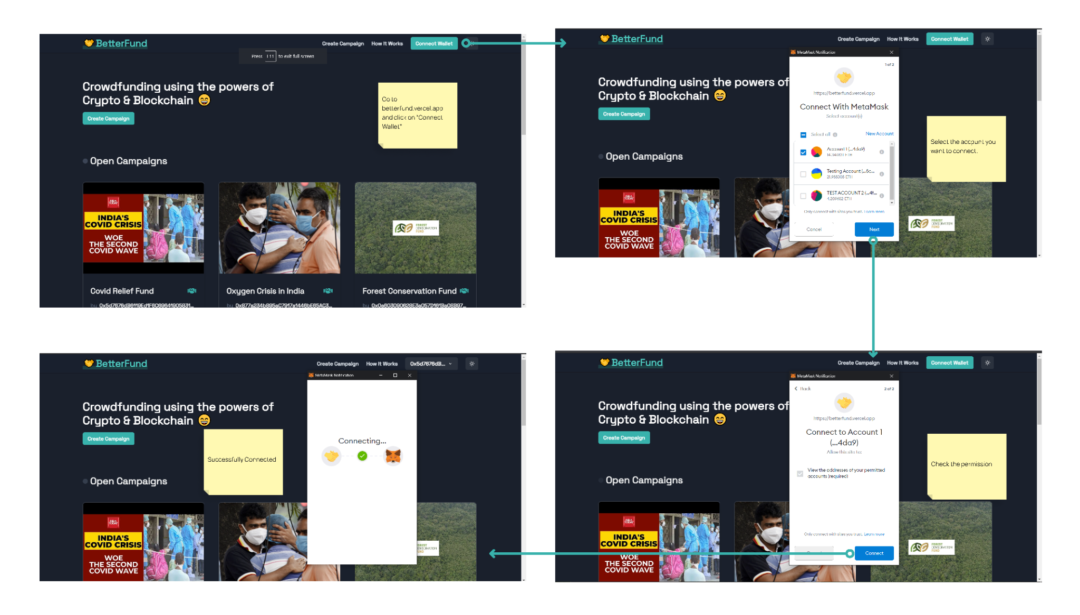
Connect Wallet

Slide 19
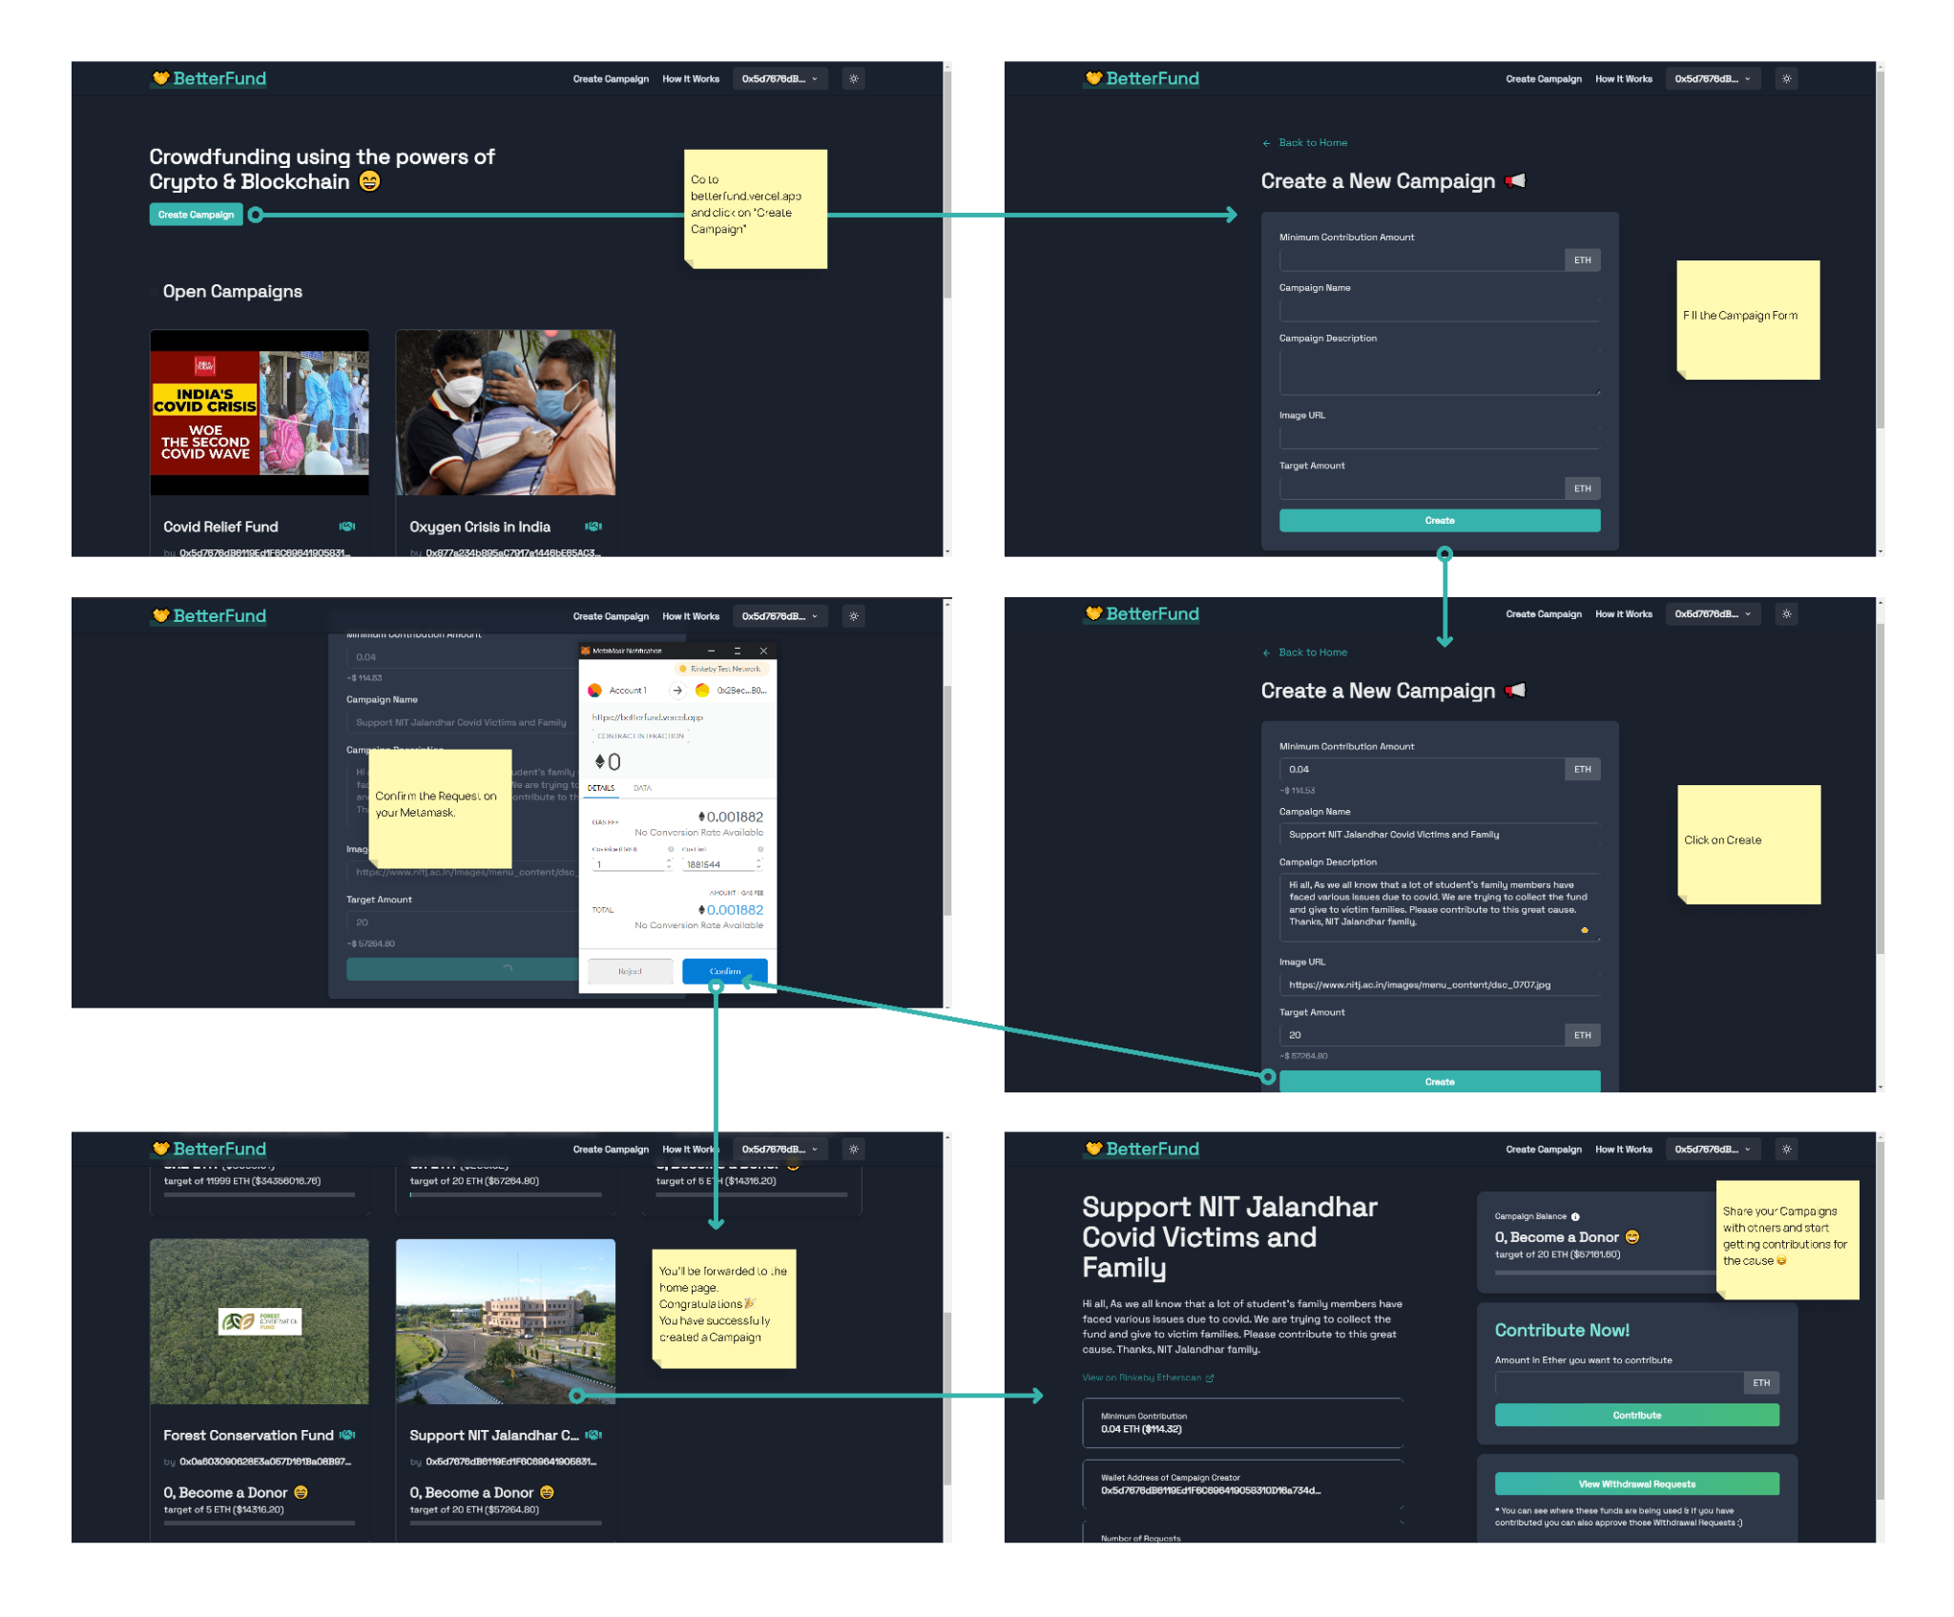
Creating a Campaign

Slide 20
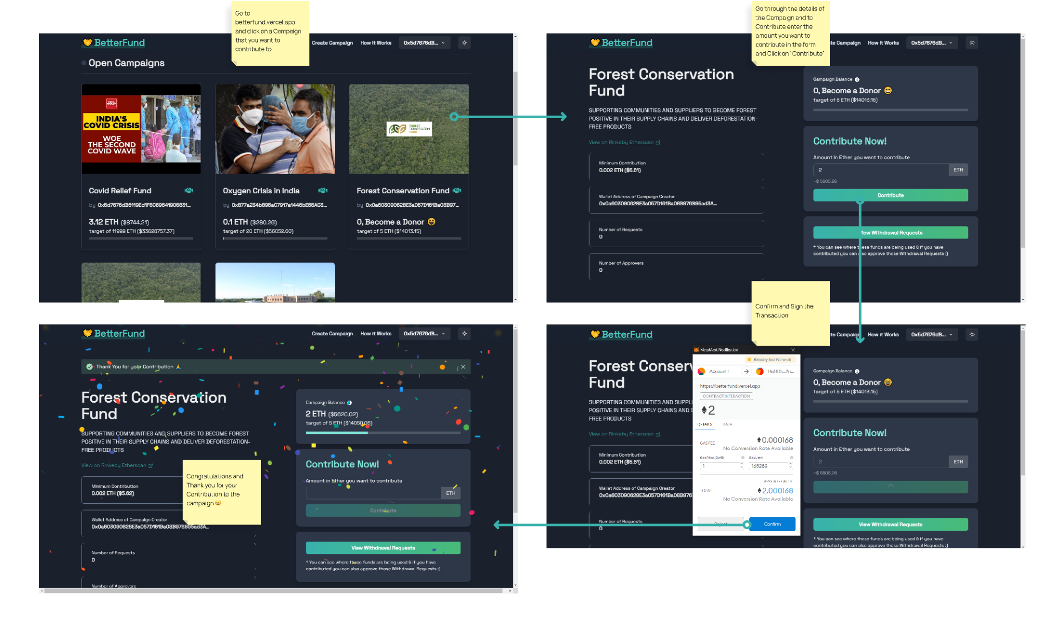
Contributing to a Campaign

Slide 21
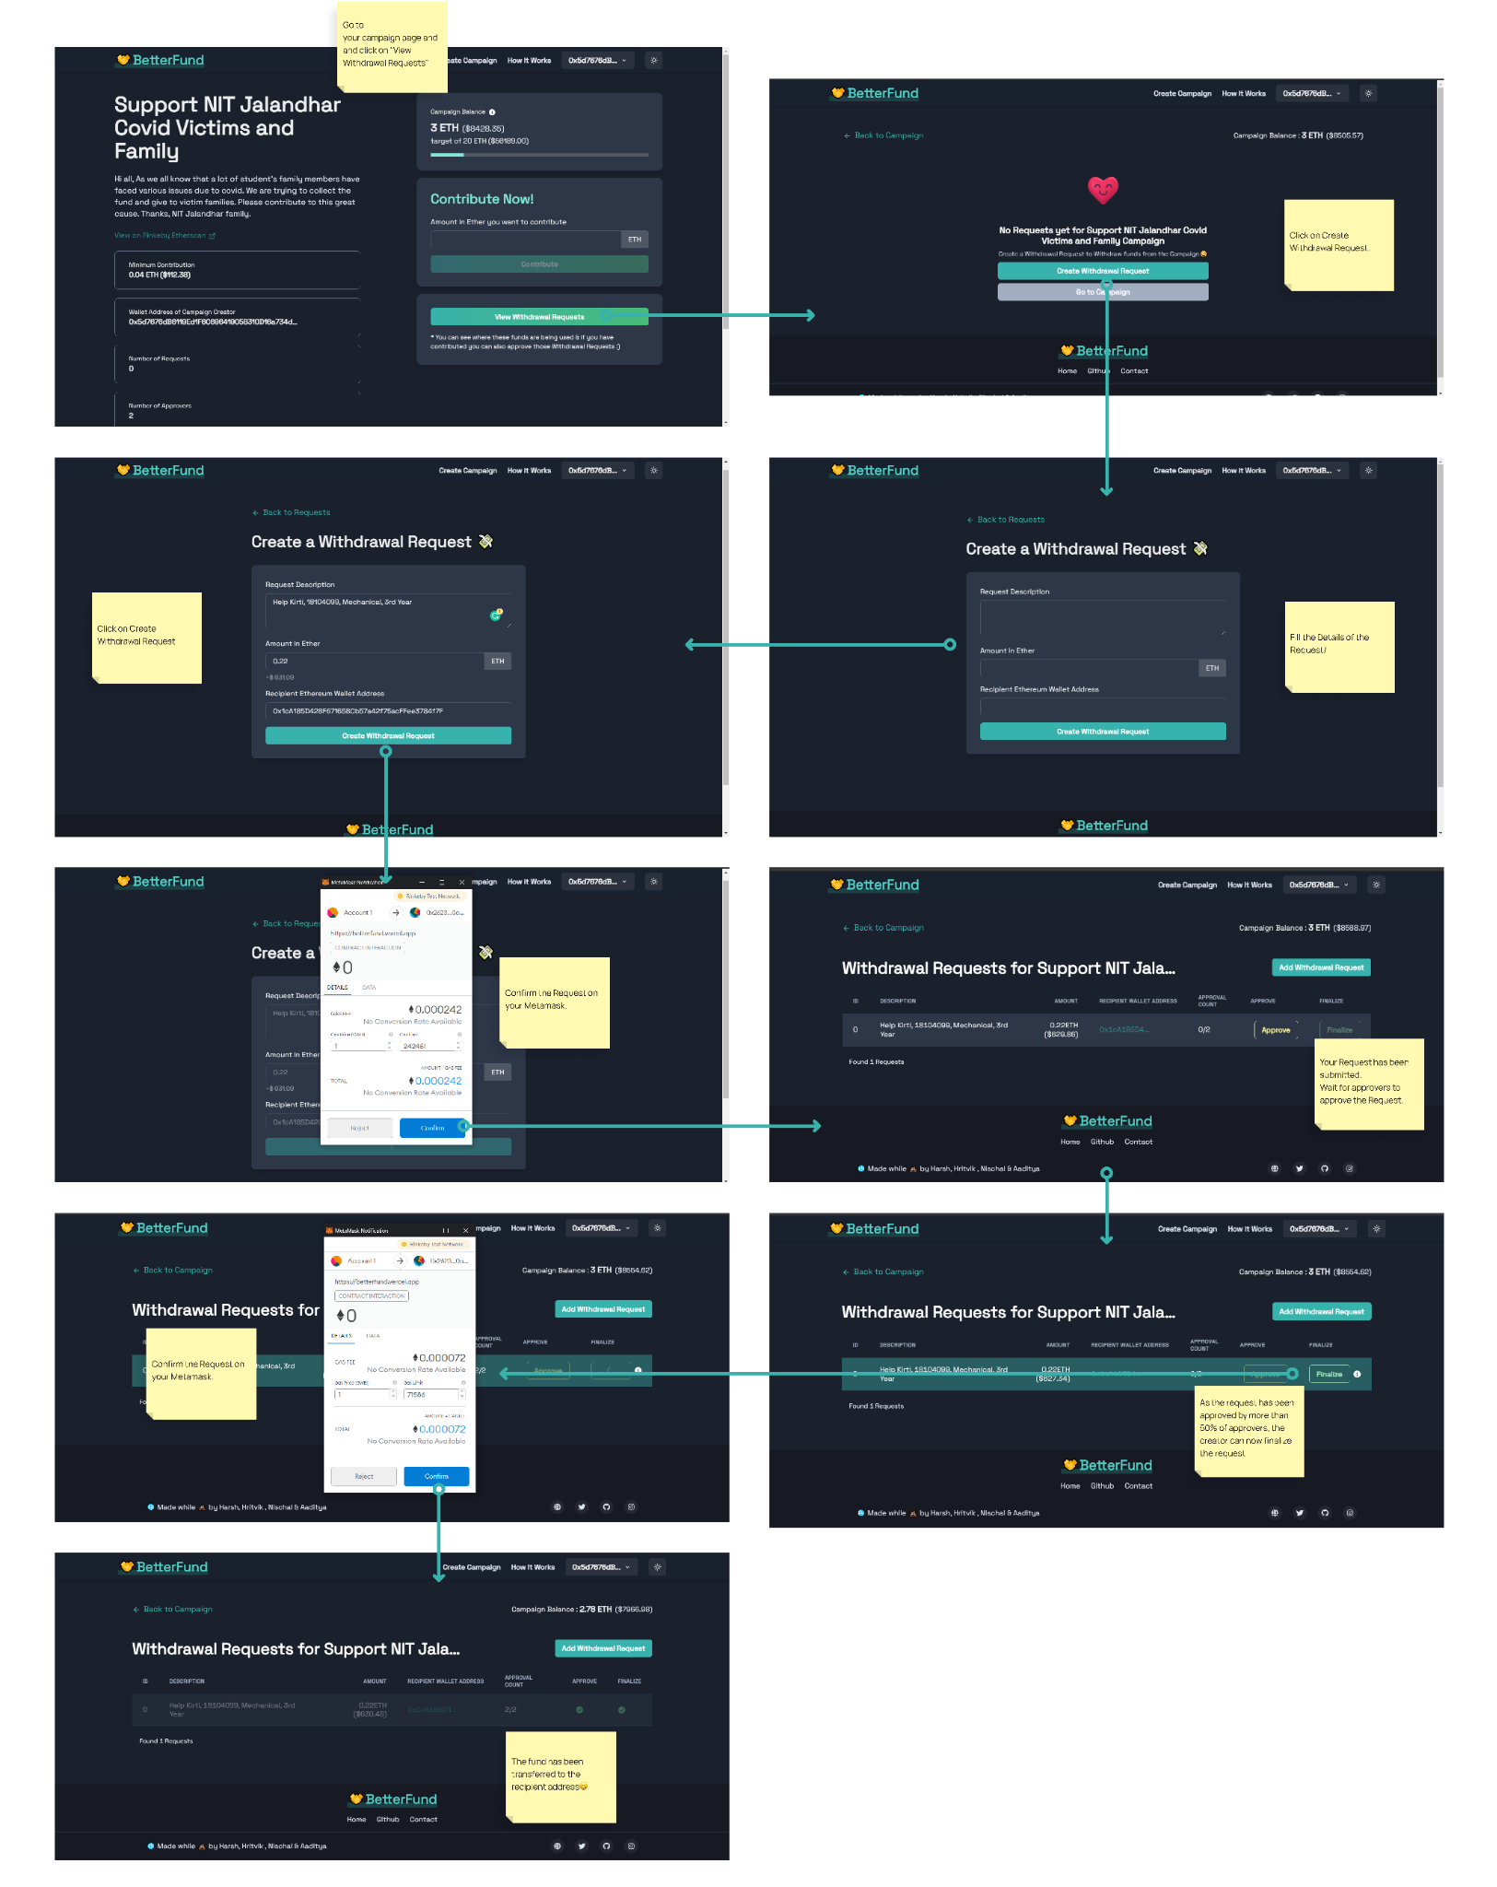
Making a Withdrawal Request

Slide 22
Algorithm : Consensus Algorithm

Slide 23
Proof of Work (PoW) based
Proof of Work (PoW) is the creation of a cryptographic hash. Generally, it requires blockchain validators to take data from the block header as inputs. Then, the blockchain validators could run the input through a cryptographic hash function continuously. Validators ensure hashing of slight changes in input data through the inclusion of an arbitrary number, referred to as a nonce.
The nonce is added with all iterations of running the input data through a cryptographic hash function. PoW algorithm used in blockchain requires higher processing power for determining the addition of data in the next block. Therefore, you may need specialized computers such as ASICs for computing complex mathematical problems required in PoW systems.

Slide 24
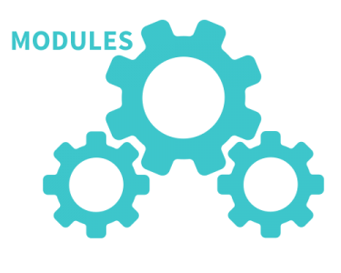
MODULES

Slide 25
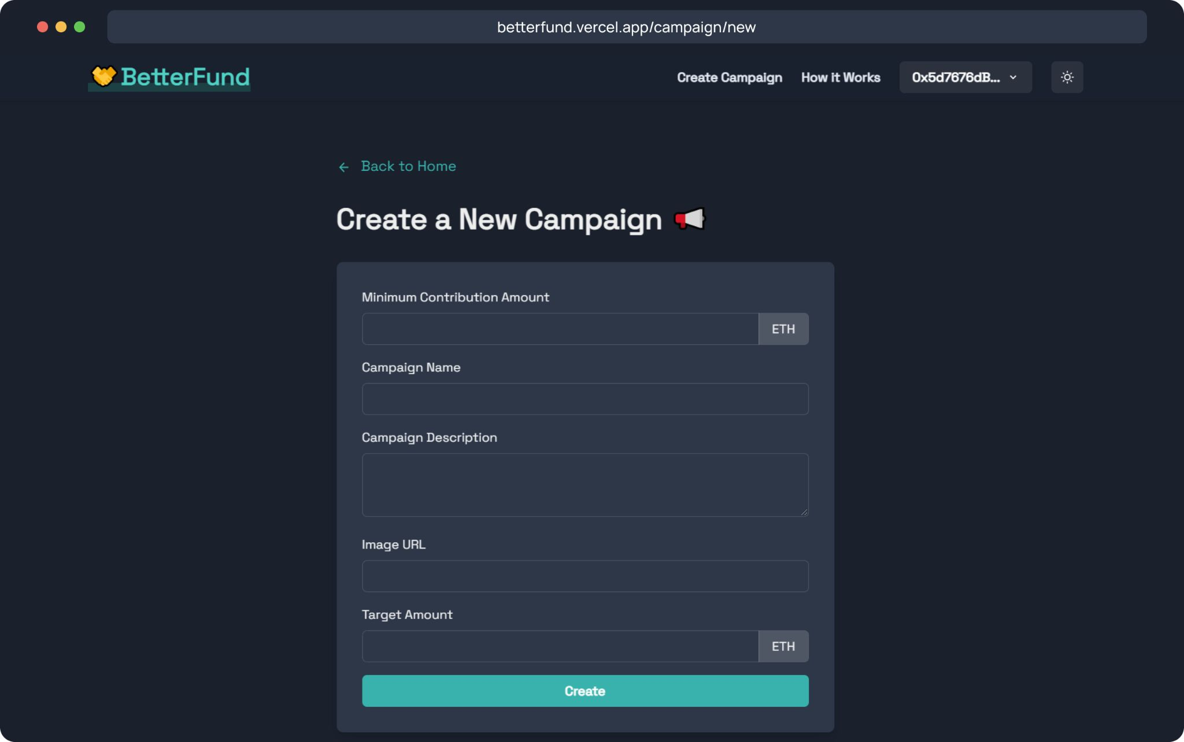
Create
Creating Campaign
Just like Crowdfunding in the real world as well as on other crowdfunding platforms, anyone can create a campaign in a few minutes. The campaign information will be managed by the Ethereum-based smart contract and thus cannot be tampered with.

Slide 26
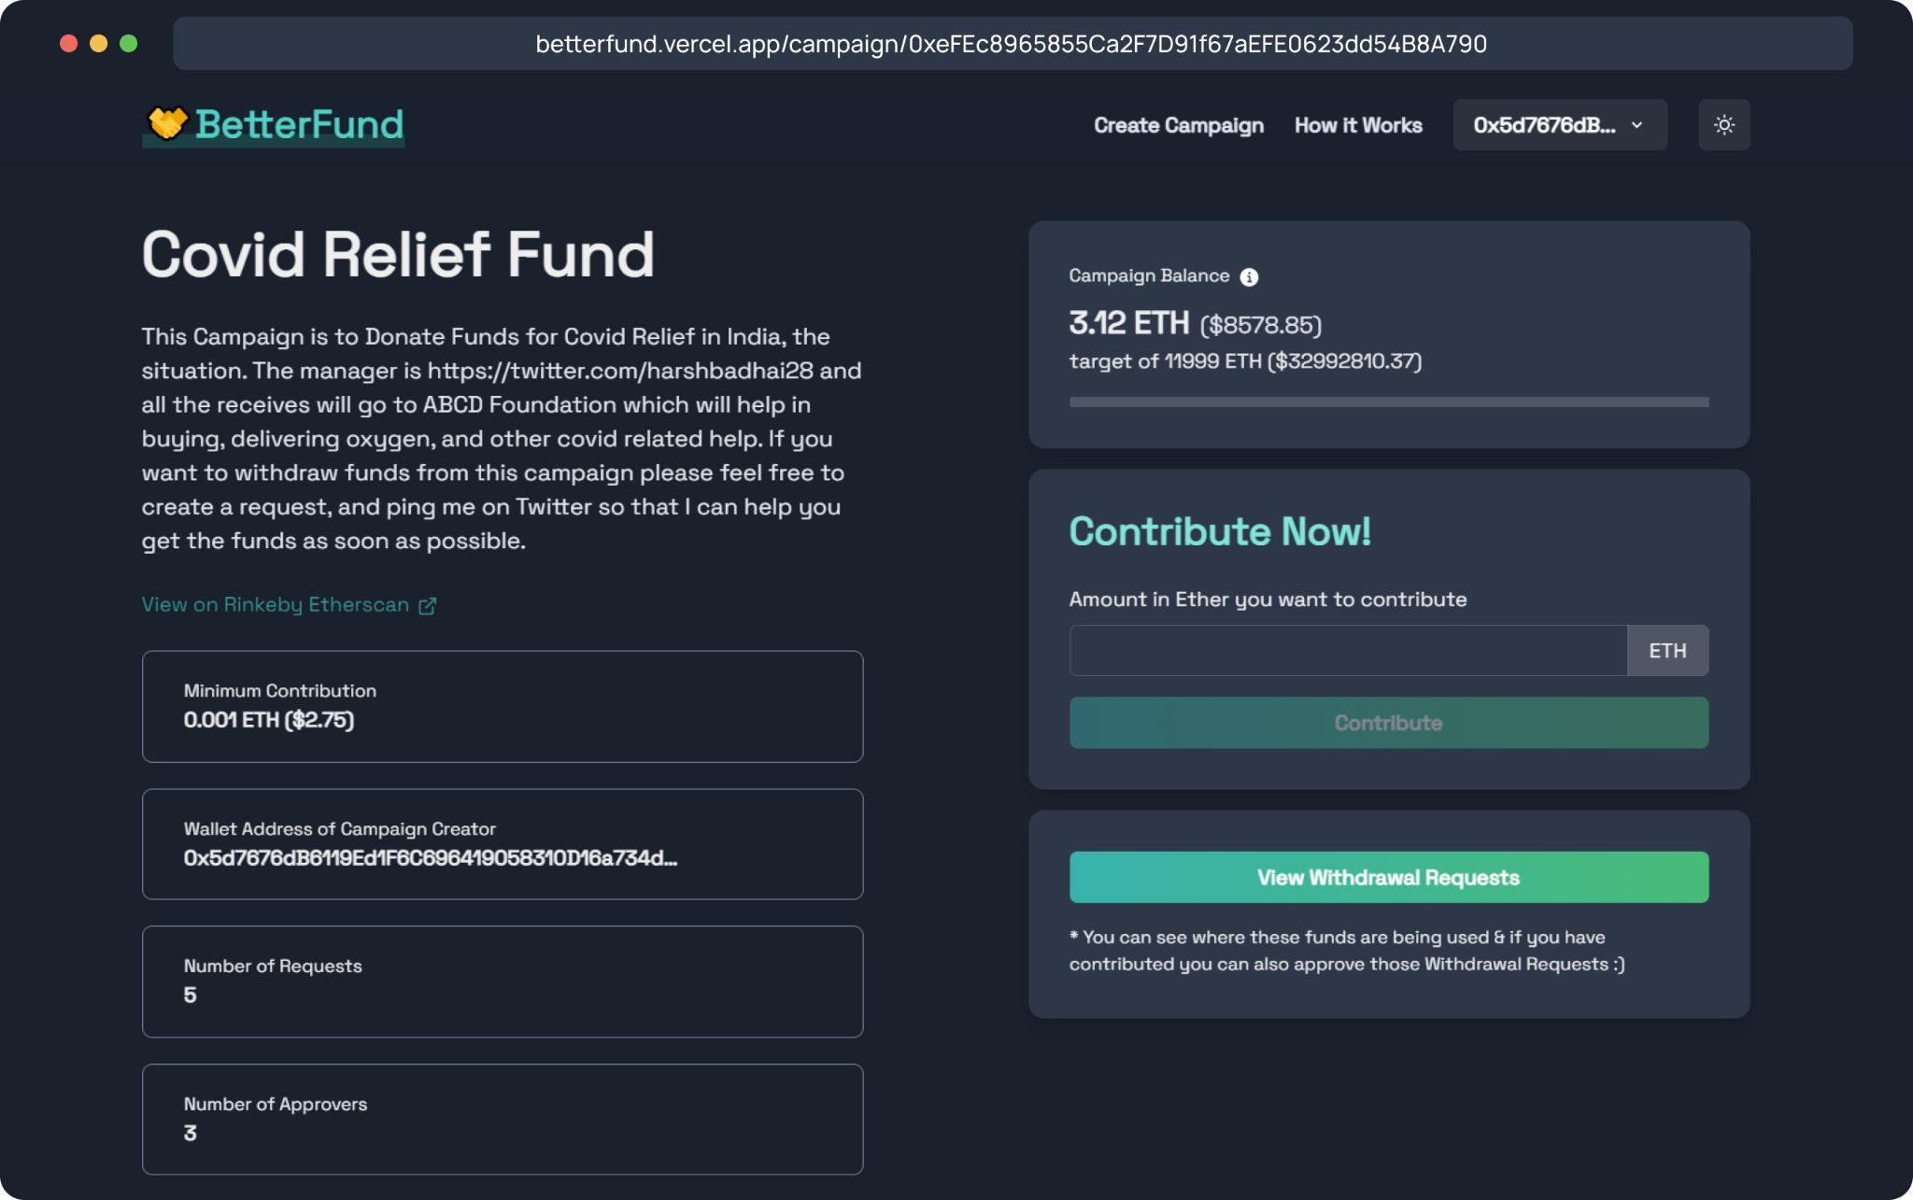
2. Contribute
Contributing to a Campaign
Once a campaign has been created, users can share the campaign and anybody can contribute to the campaign. The funds will go to the address of the campaign and not to the creator of the campaign, thus making the process more efficient and anti-fraudulent.

Slide 27
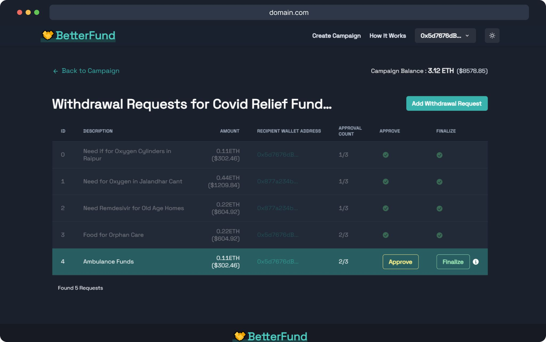
3. Withdraw
Withdrawal of Funds
The Creator of a Campaign can propose how to use the funds in the form of a Withdrawal Request. Anybody who contributes more than a particular amount is called an approver, and will be able to approve or deny the request.
Funds can’t be withdrawn without the approval of 50% approvers.

Slide 28
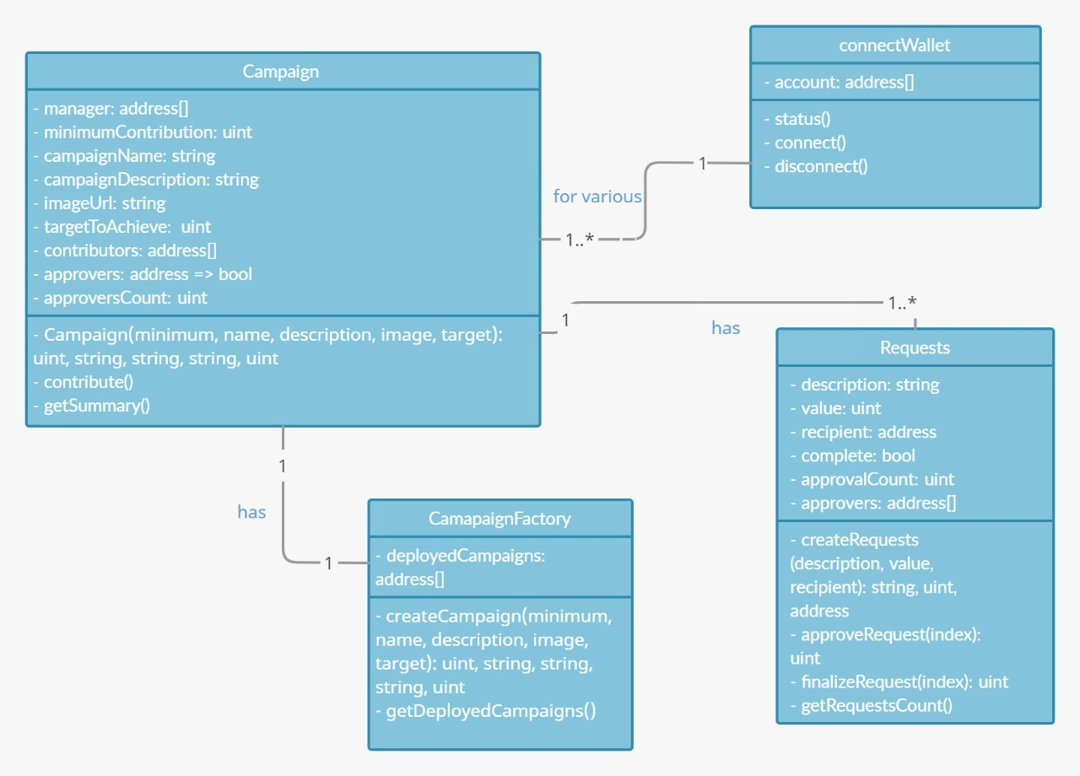
UML Diagram
Class Diagram
The Classes defined are:
Campaign
CampaignFactory
Requests
connectWallet
The Relationships defined are:
A User connects his wallet to support various campaigns; one to many.
A campaignFactory has its Campaign; one to one.
A Campaign has multiple Requests; one to many.

Slide 29

EXPERIMENTAL RESULTS

Slide 30
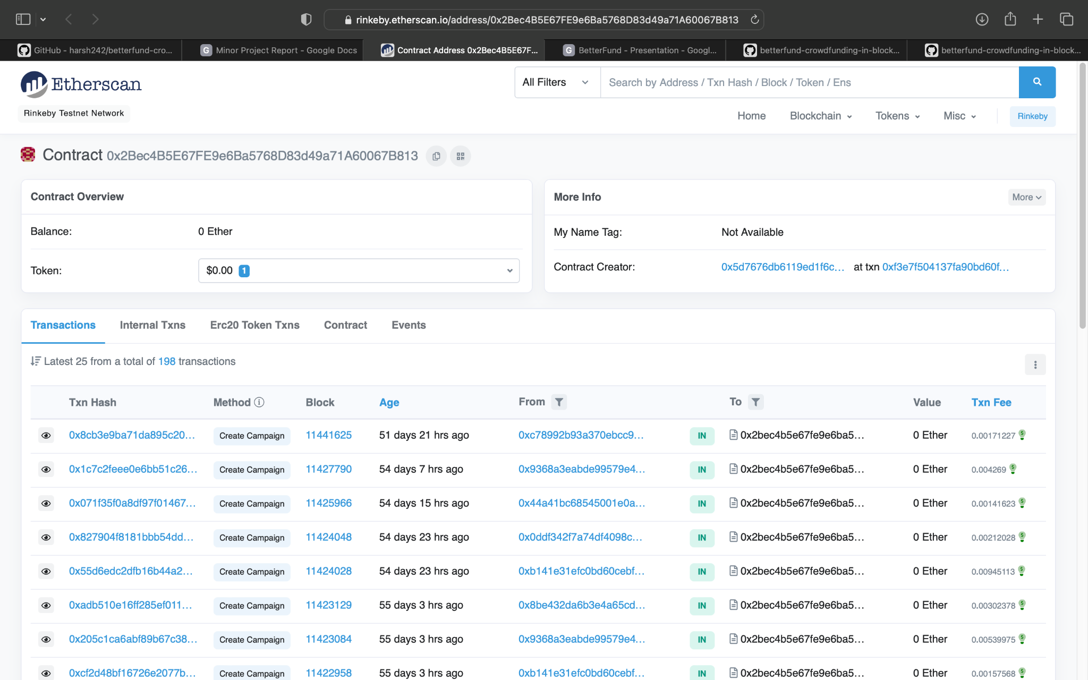

Slide 31
OUTPUT SCREENSHOT

Slide 32
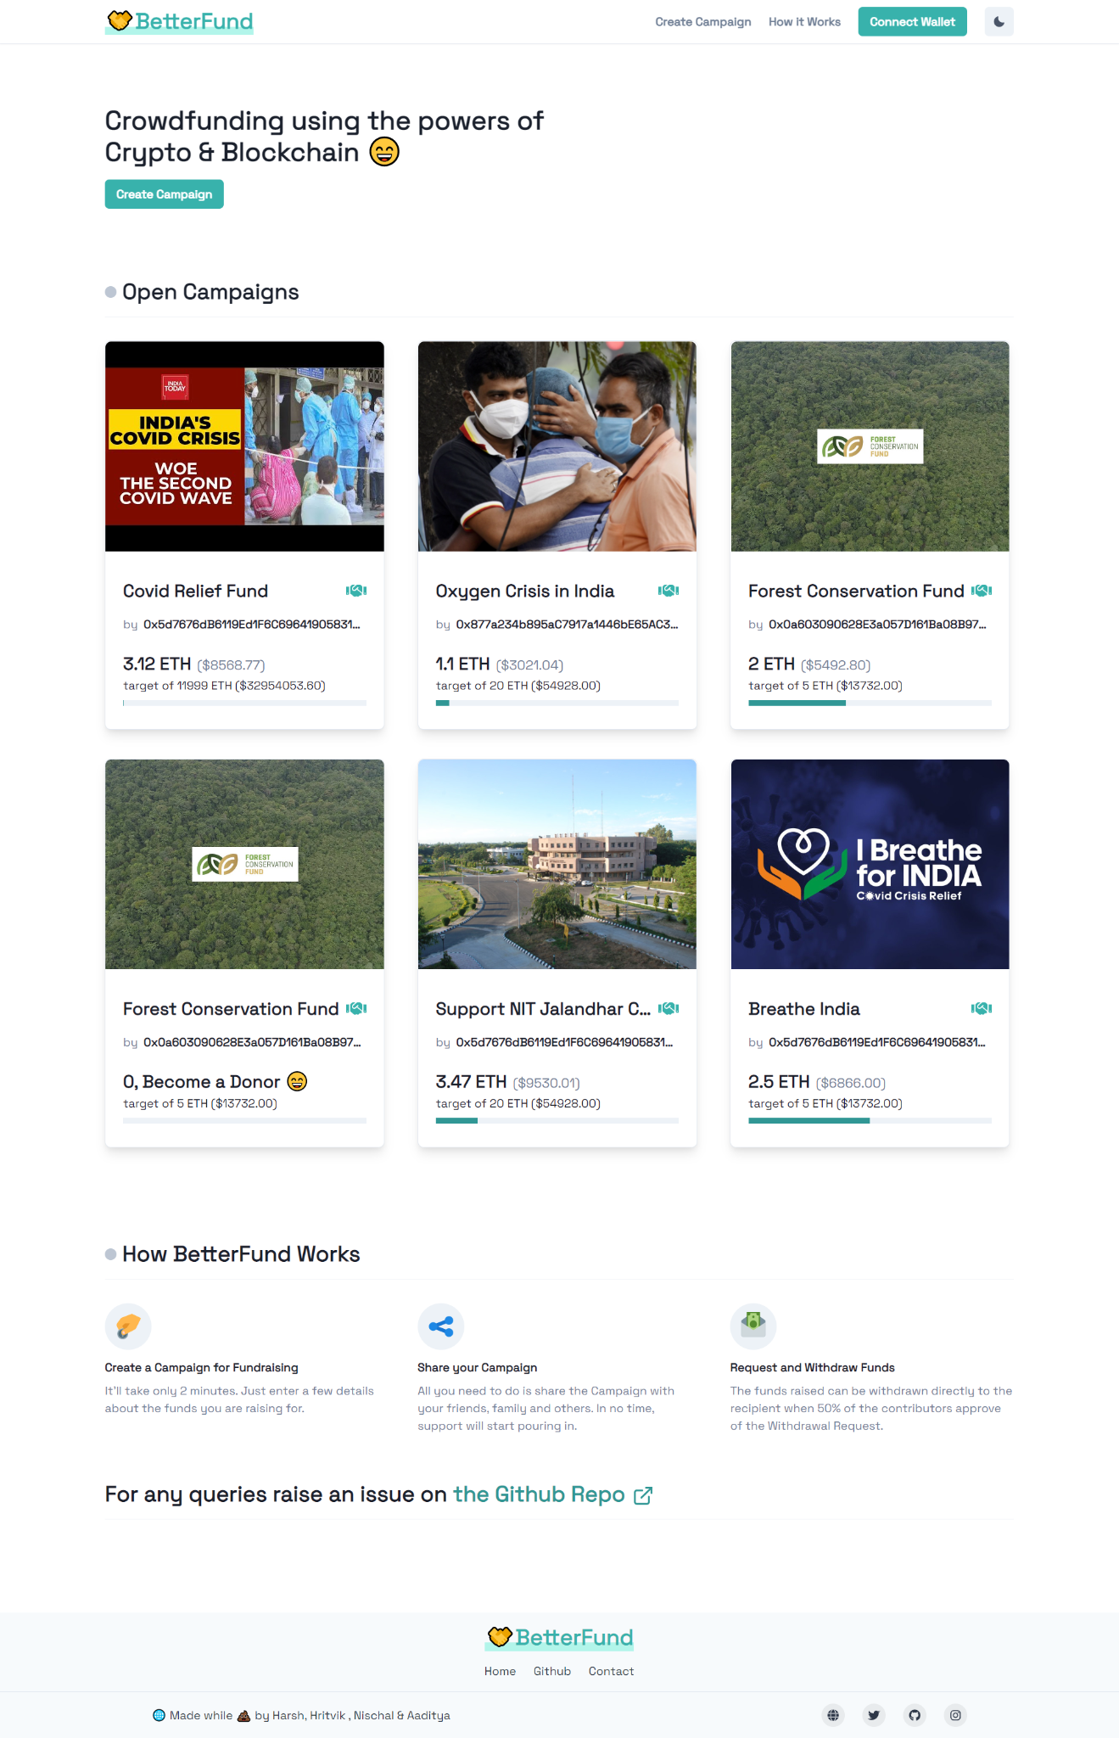
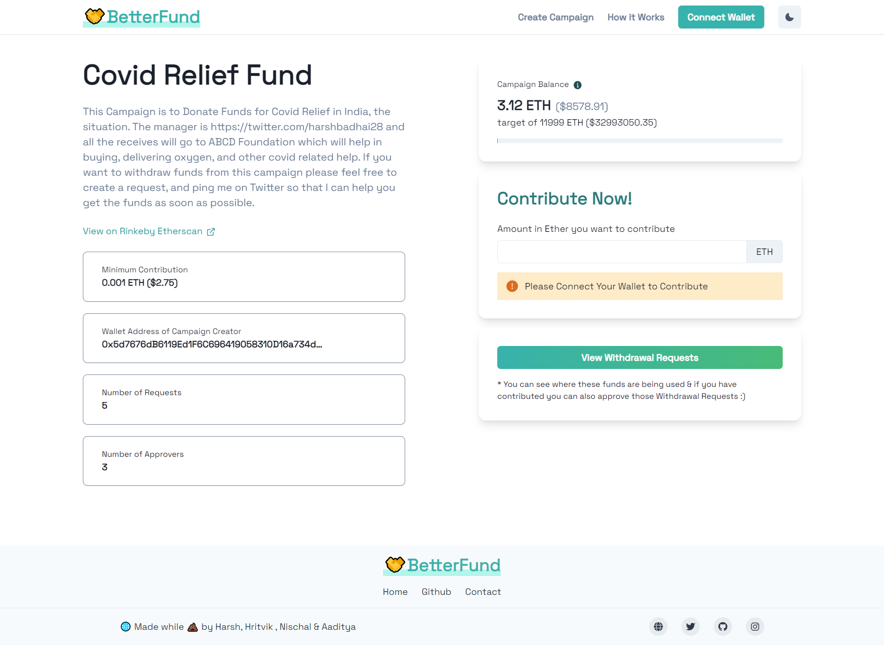

Slide 33
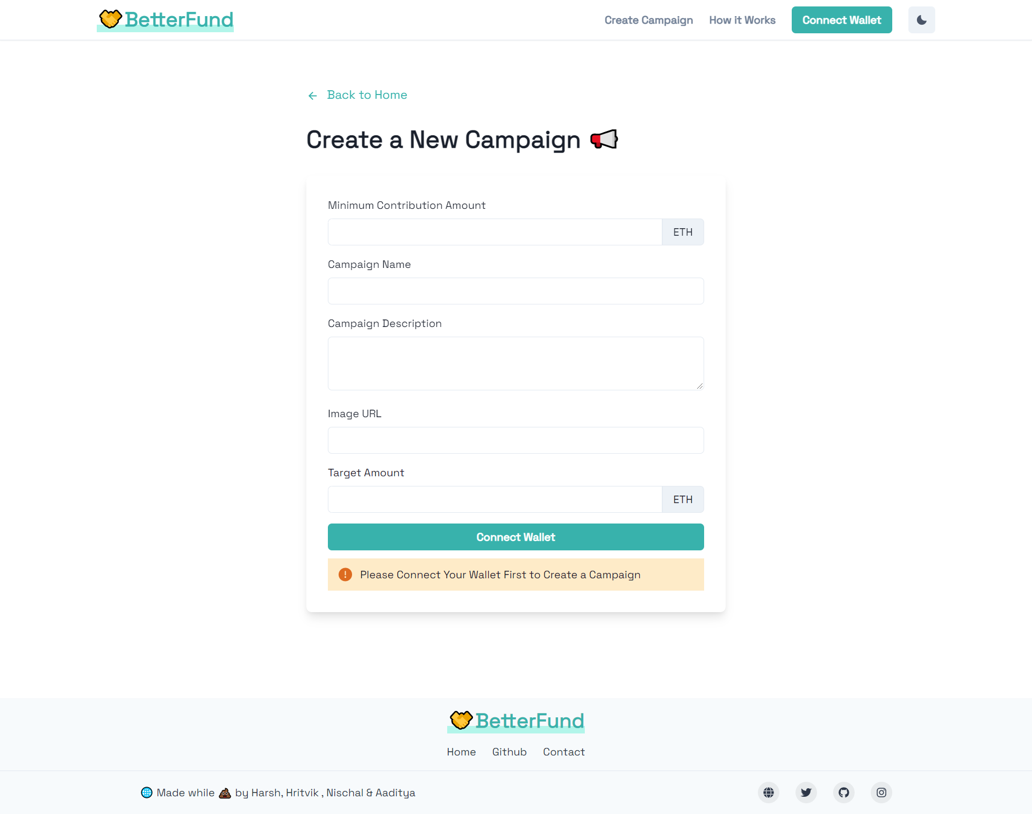
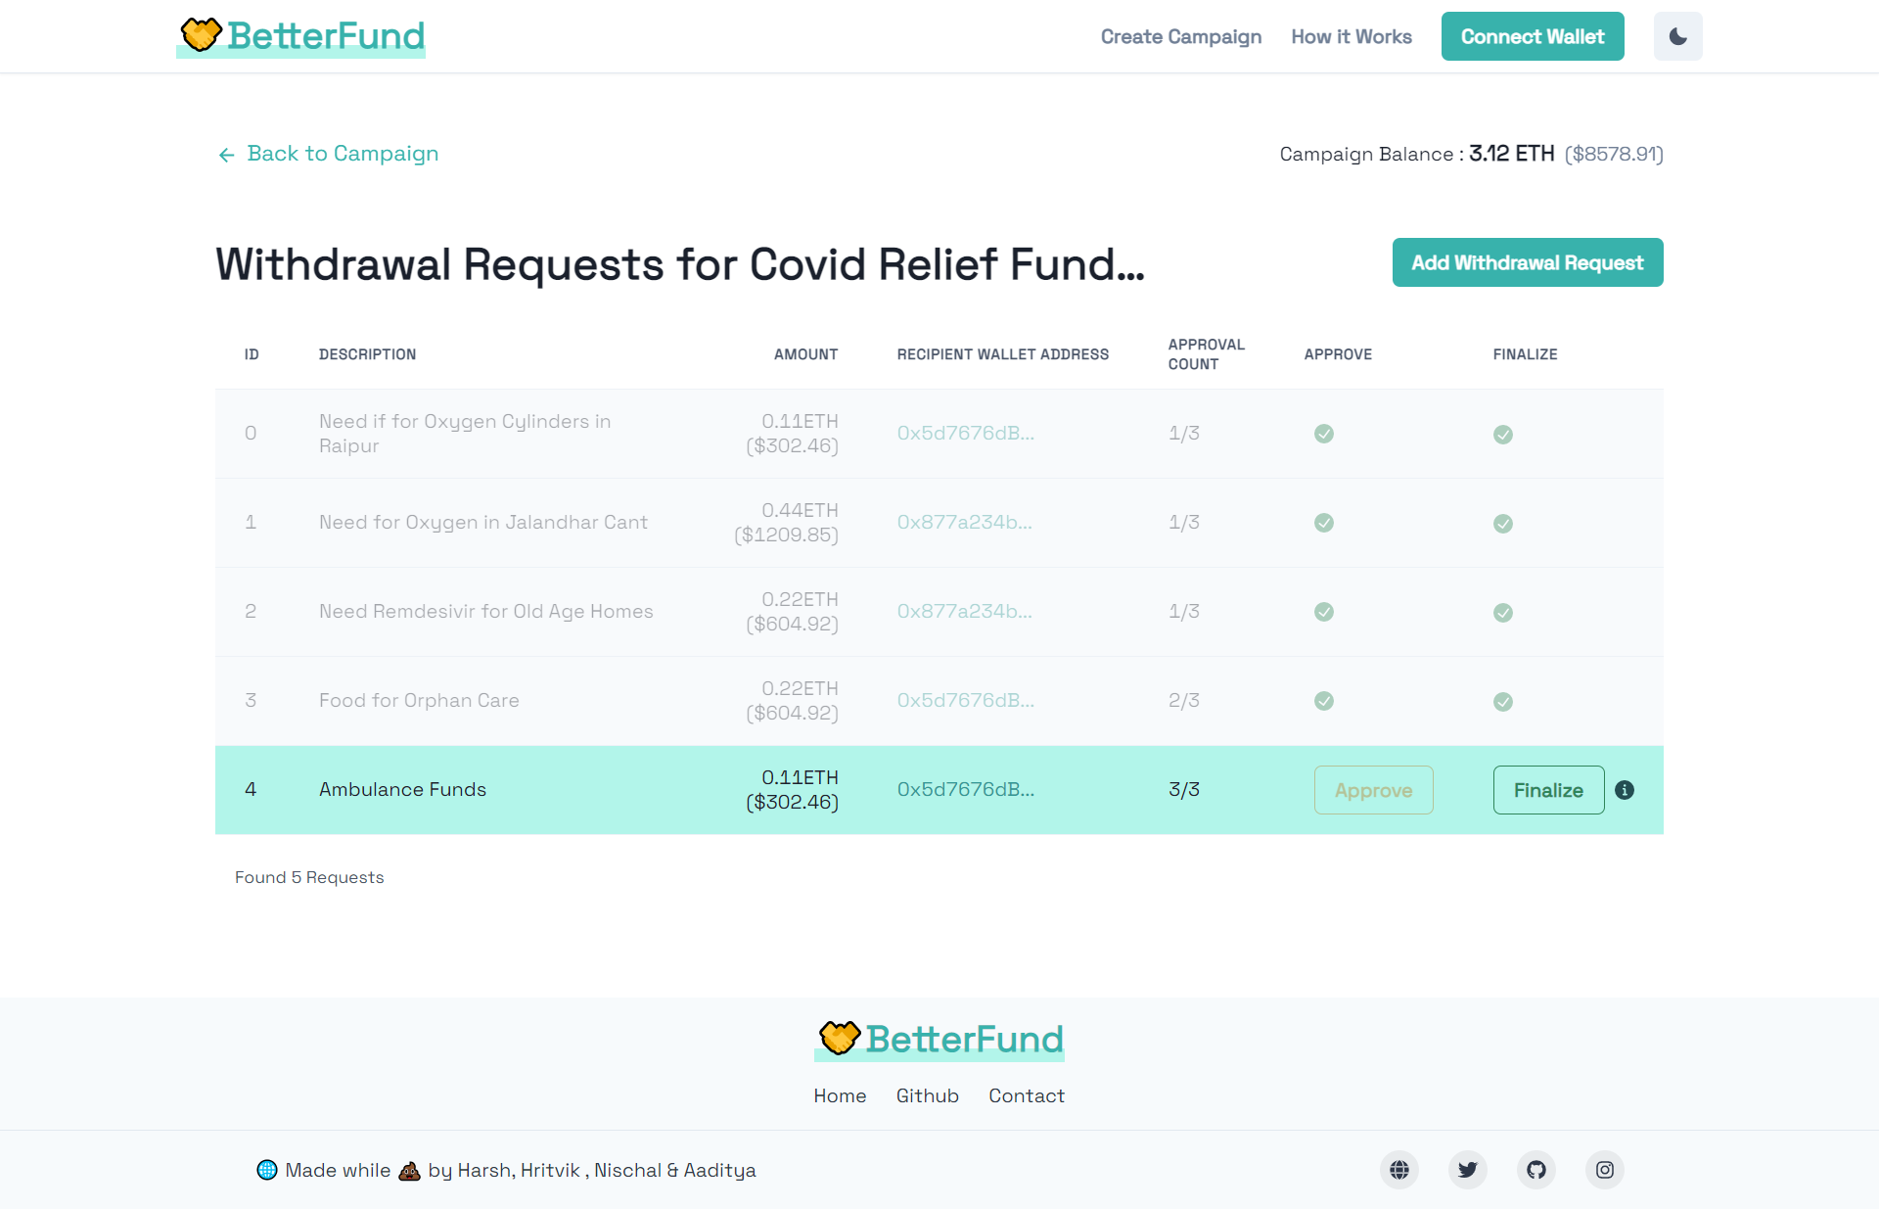

Slide 34
CODING

Slide 35
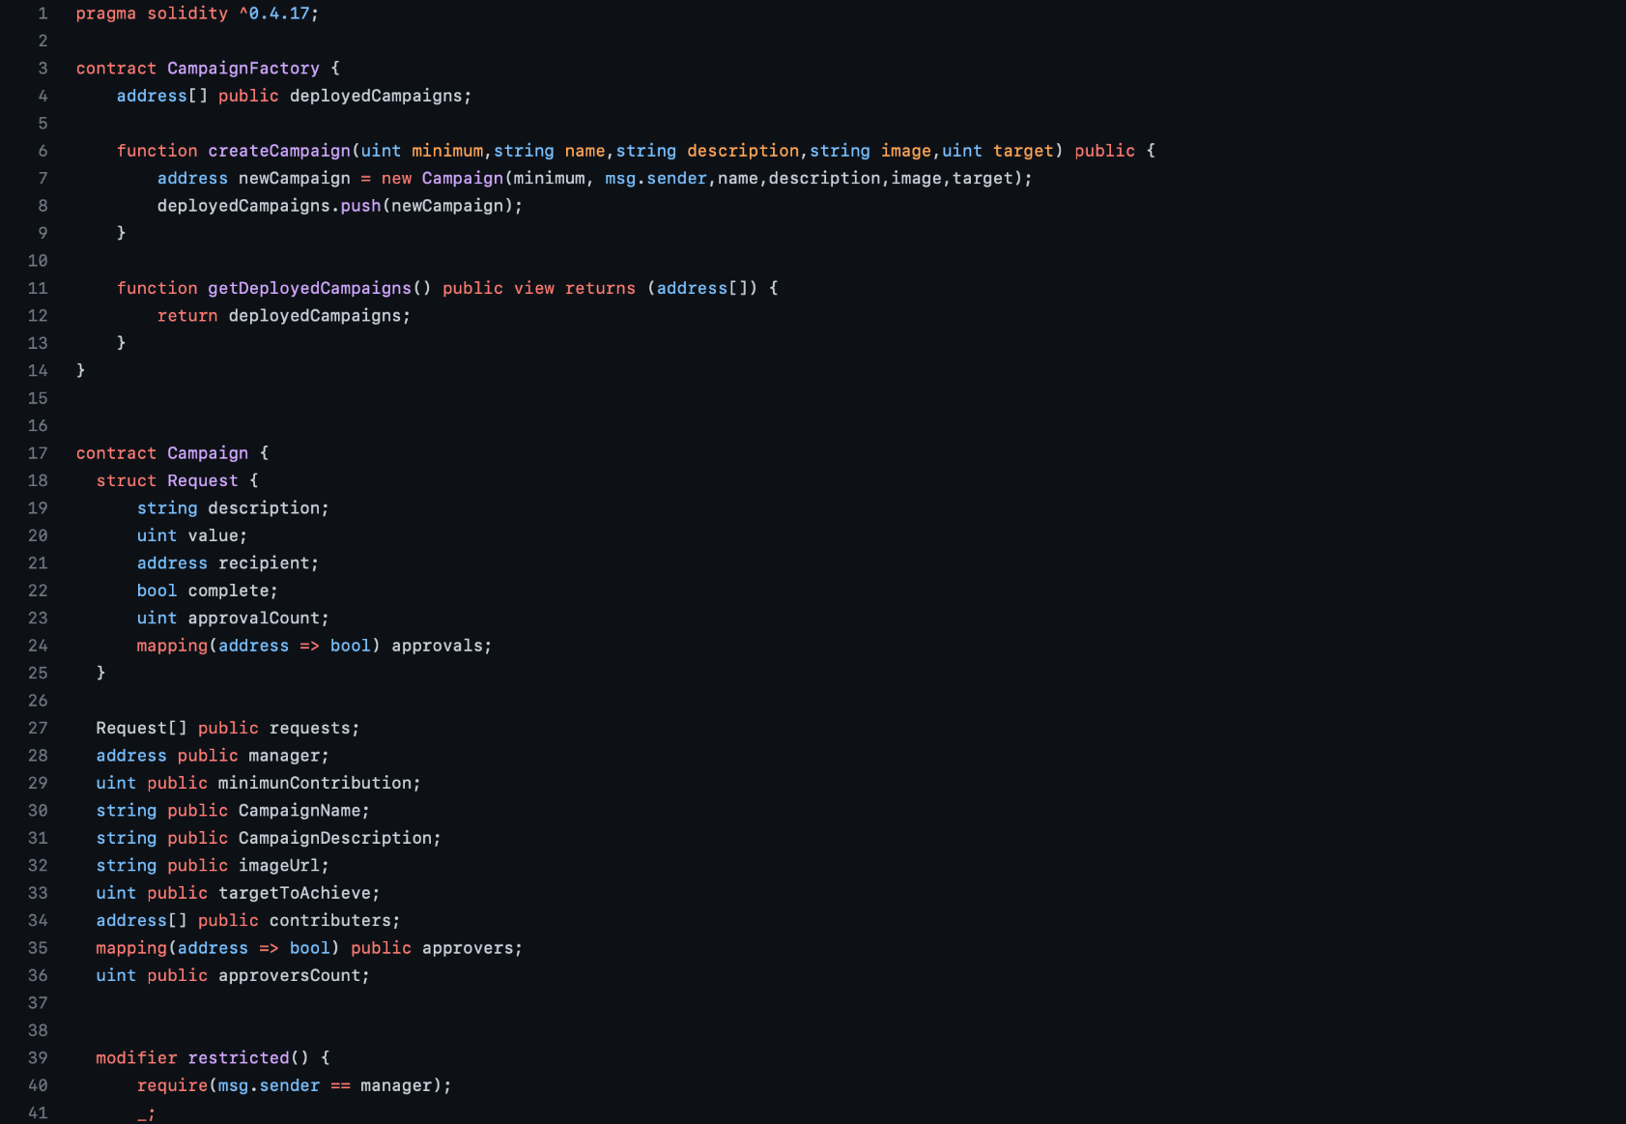

Slide 36
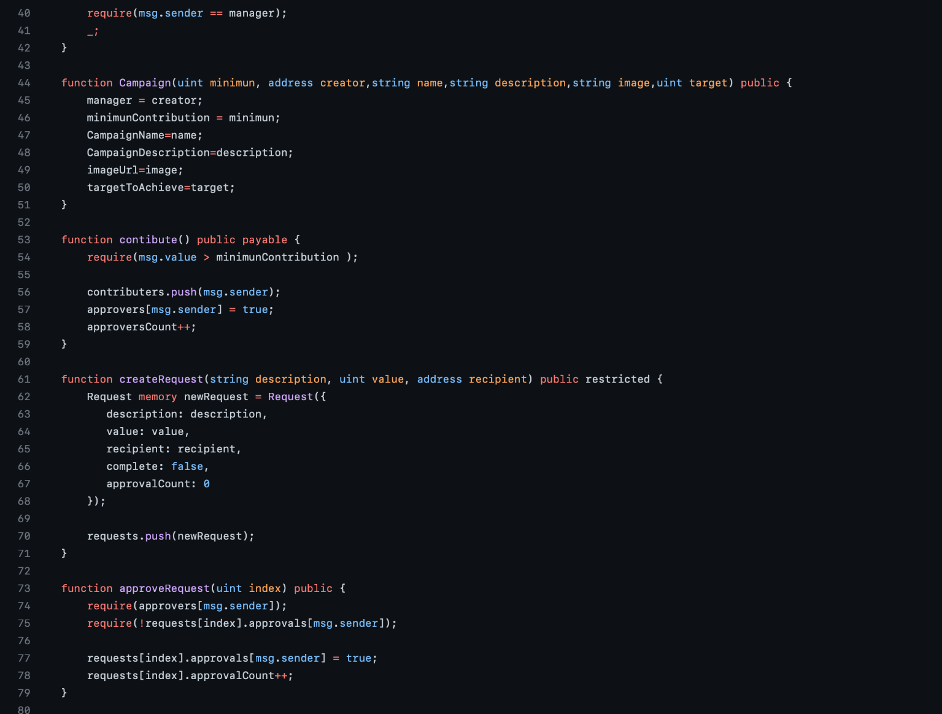

Slide 37
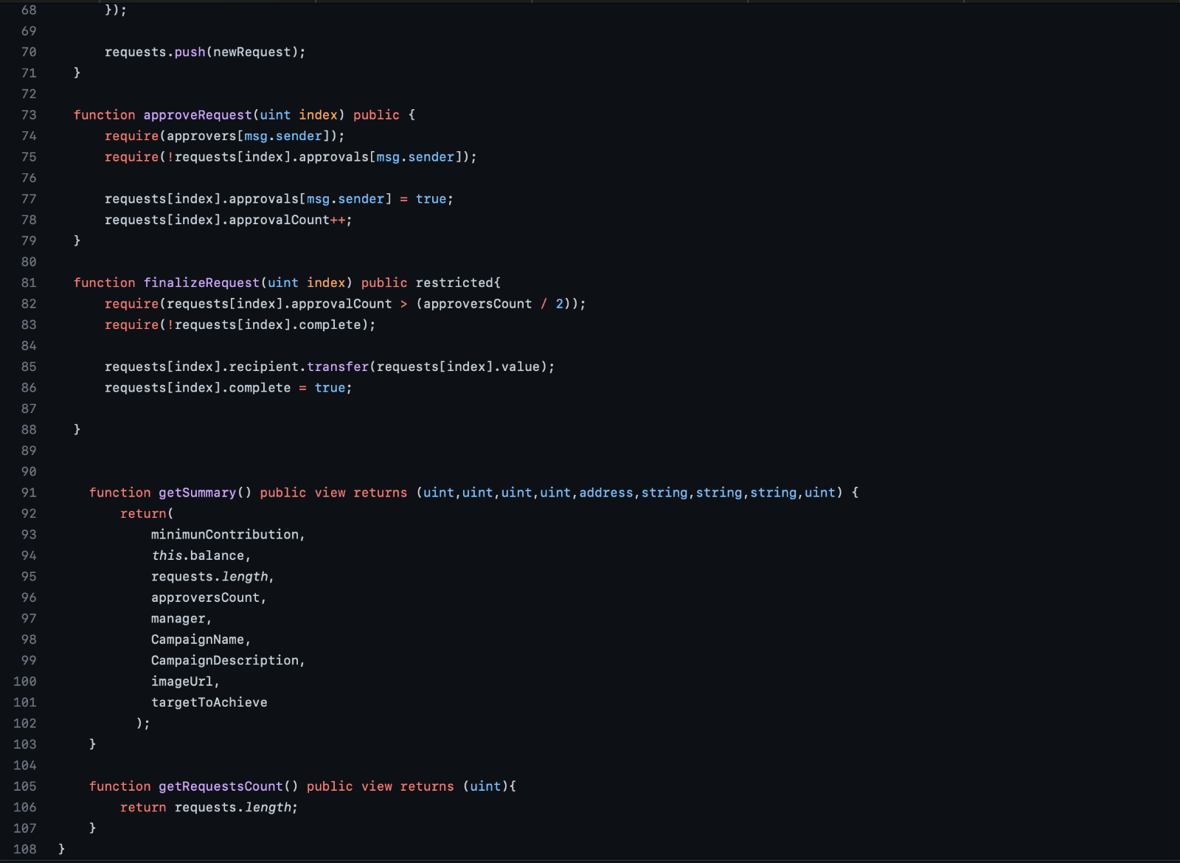

Slide 38
Conclusion
Conventional crowdfunding methods have long suffered from lack of transparency and fraud. It is an avoidable problem, and we believe that we have implemented a solid solution that can do away with these long-standing problems.
The aim to have a transparent, anti-fraudulent, decentralized platform has been achieved to a great extent. This project has covered the weak points of general crowdfunding platforms to provide transparency to the process of crowdfunding and build trust among people, so that they may contribute their wealth to good causes without fear of fraud.

Slide 39
References
Blockchain and Smart Contracts : https://www.dappuniversity.com/articles/how-to-build-a-blockchain-app
CryptoRelief Platform : https://cryptorelief.in
NextJS Documentation : https://nextjs.org/
Learning Solidity Language : https://cryptozombies.io/
Web3.JS - Ethereum Javascript API : https://web3js.readthedocs.io/en/v1.3.4/
How Data is stored in Ethereum Blockchain : https://laurentsenta.com/articles/storage-and-dapps-on-ethereum-blockchain/
Metamask Ethereum Wallet : https://metamask.io/
Rinkeby Ethereum Test Network : https://www.rinkeby.io/#stats

Slide 40
Thank You

